Slide 1
Gendered dimensions of policymaking
Gender and Economic Policy [session 1]
November 2018
WISE Centre for Economic Justice
Glasgow Caledonian University
Professor Sara Cantillon
Dr Angela O’Hagan
Dr Rosalind Cavaghan

Slide 2
sTructure of today’s session
Introductions
Focus on Scotland’s Economic Policy
Understanding gender
Gendered dimensions of policymaking
Gender and institutions
Gender Mainstreaming
Break
Gender, Data and Analysis
Group Exercise and Feedback
Session ends at 4pm

Slide 3
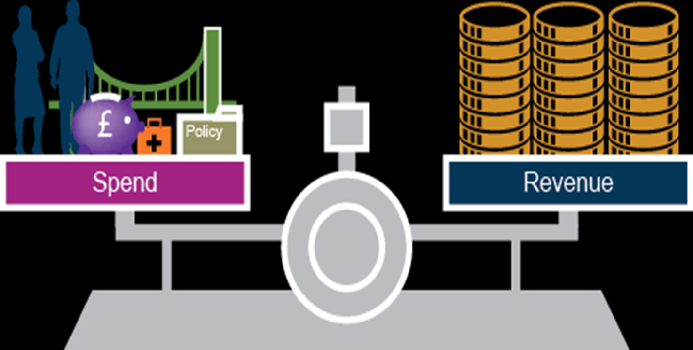
Focus for scotland
“ A society which is fair and equitable underpins a strong economy. That thinking is now underpinning the approach the (Scottish) government is taking to the formulation of the next iteration of the economic strategy.”
(John Swinney MSP, 2016 in Feminist Economics and Public Policy)

Slide 4
Gender and economic policy
“There is strong evidence that gender equality can promote economic growth.
Women’s access to employment and education opportunities reduces the likelihood of household poverty, and resources in women’s hands have a range of positive outcomes for human capital and capabilities within the household.
However, the converse relationship – that economic growth promotes gender equality – is less strong.”
(Naila Kabeer, 2012)
“Since 2007, this Government’s central purpose has been to create a more successful country, with opportunities for all of Scotland to flourish, through increasing sustainable economic growth.”
(Scotland’s Economic Strategy, 2017)

Slide 5

Gender is woven into our– often implicit ideas and perceptions in all areas of life
Gender is a structural factor in the distribution of power, resources and opportunities

Slide 6


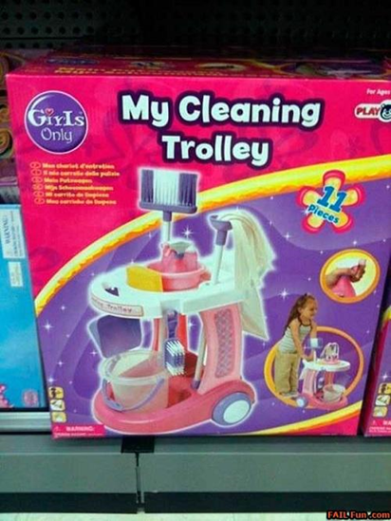

Gendered Constraints
Care and provisioning
Labour market segregation and segmentation
Availability of social care and childcare
Public services
Access to education
Attitudes to care, caring, household
Social Security and taxation systems

Slide 7
Responses to gendered constraints
Recasting gender relations
Family responsibilities
Time use
Household management
Employment practices
Organising women’s voices - trade unions, civil society
Parental and Carers’ leave – and take up
Attitudinal change
Role models
Representation and presence in public and political life
Basic Income

Slide 8
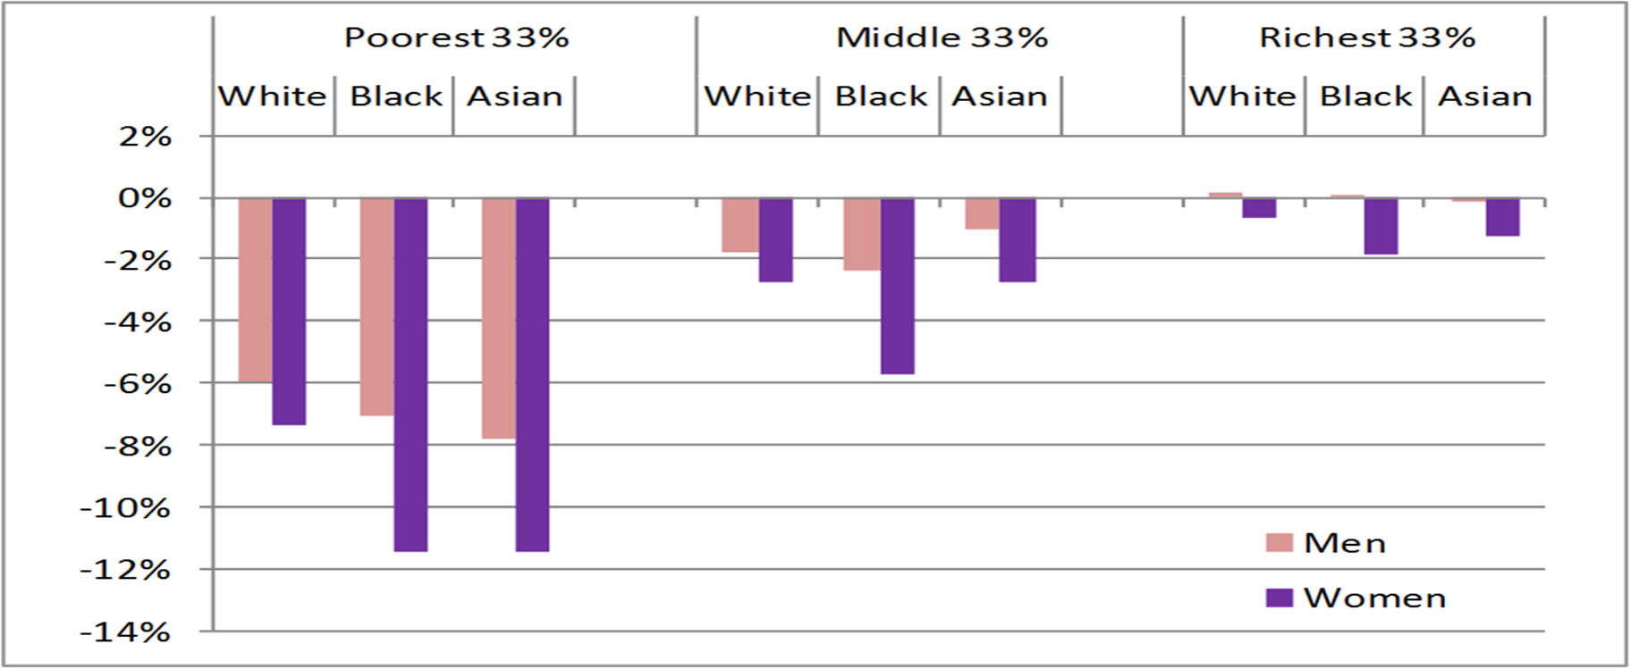
Gender and policy making: Intersectionality
Gender intersects with other factors such as race, class, age, disability, and sexual orientation
Consider for example the impact of tax and benefit changes on Black and Asian women.

Slide 9
Theorising Gender and Policy
Gender is a socio-cultural construction – mutually accepted ideas about male/female interests and abilities (e.g. male breadwinner/female care-giver)
Gendered expectations and stereotypes underpin behaviours e.g. labour market participation
‘Preferences’ formed within gender framework
Unequal outcomes are seen a product of the gender framework (e.g. women’s skills are systematically undervalued as they are seen as ‘natural’)
‘add women and stir’ approach – sex, not gender
Assumptions of gender neutrality in public policy and economics are erroneous as they are “imbued with male bias” (Elson, 1995).
The outcomes that follow from public resource allocation are not gender neutral but perpetuate gender inequality as the policy making process is “gender-blind” (Elson, 1997).
Notes:
Gender is a social scientific word to describe the socially constructed ideas about 1) people’s characteristics on the basis of their sex and 2) the appropriate behaviours and distribution of roles as a result.
International and historical comparison shows gender varies over time and culture and even between different work places/organisations
Thus gender and gender inequalites can be changed and challenged
The state is a key regulator of gender through its public policy

Slide 10
Gender and policy making: What Maintains these problems?
Androcentric assumptions in policy making
Unequal outcomes are seen as ‘natural’ or non-problems
Exclusion of women in policy making – as civil society or decision makers
Lack of expertise/training
Lack of political commitment

Slide 11
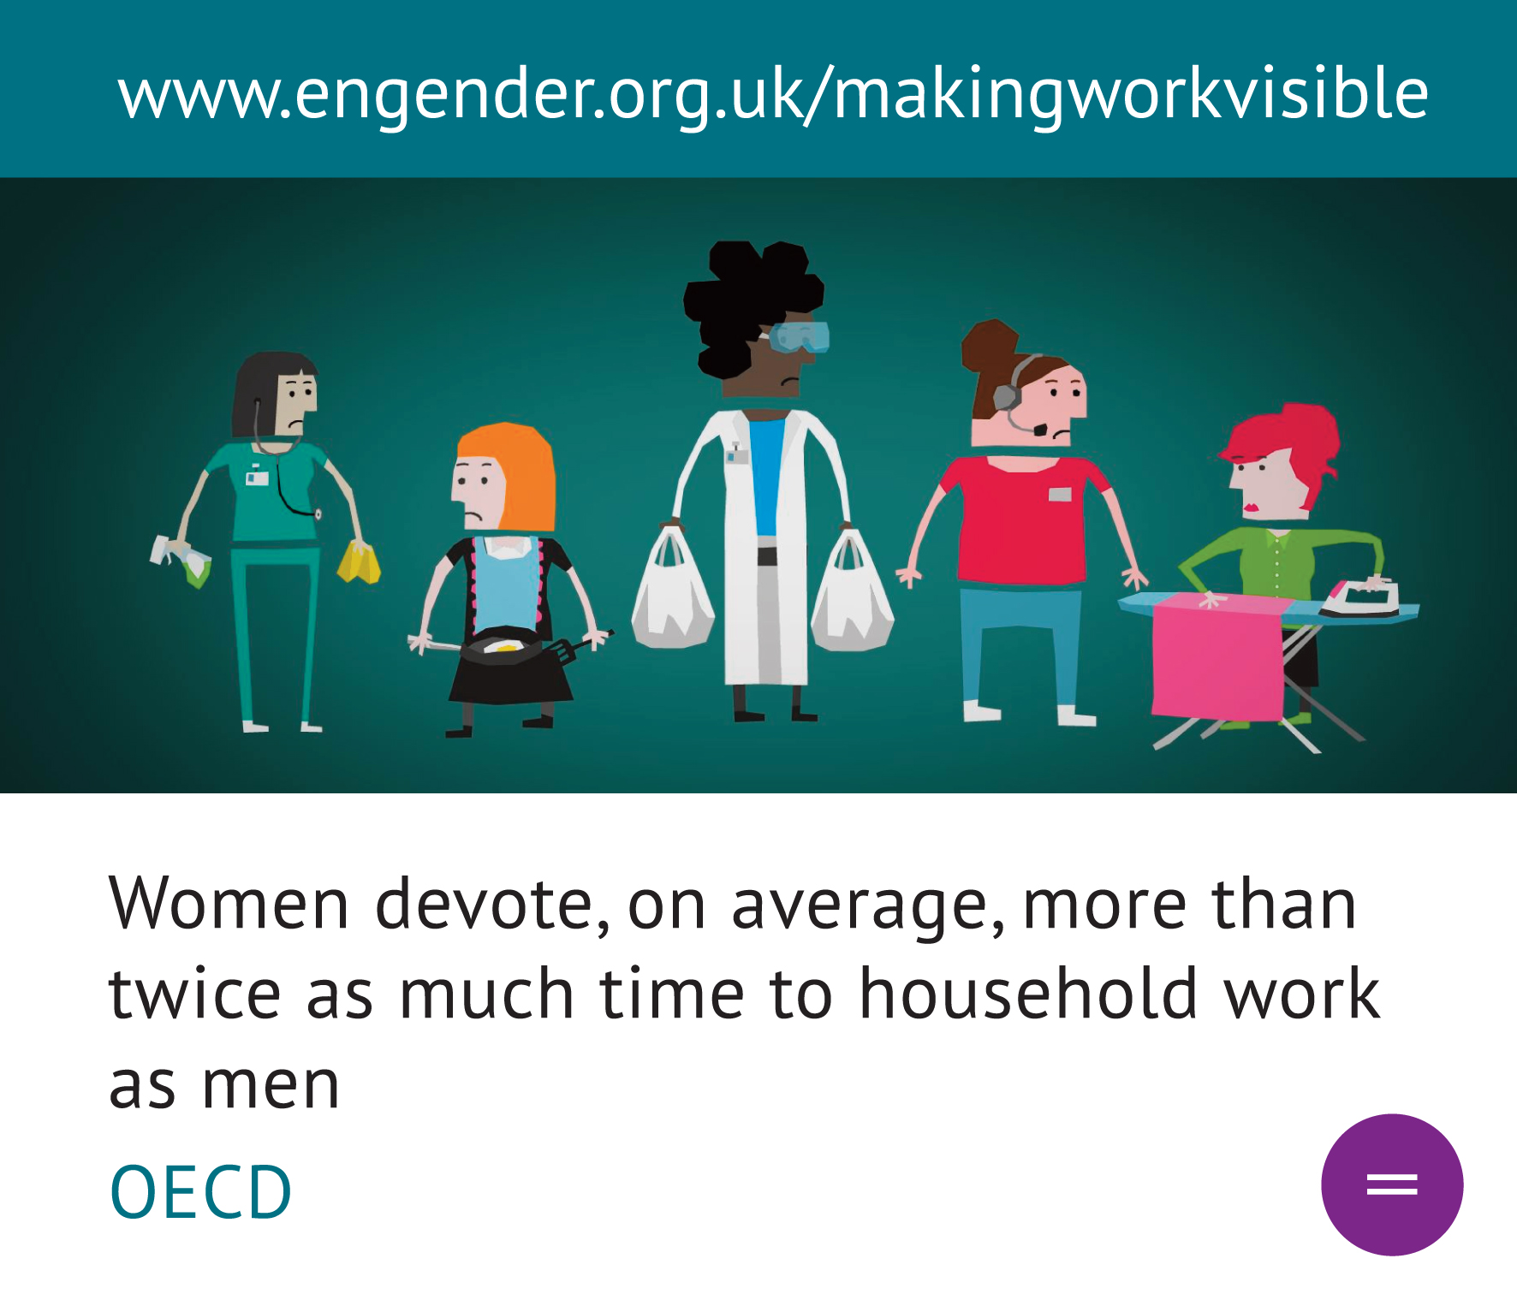
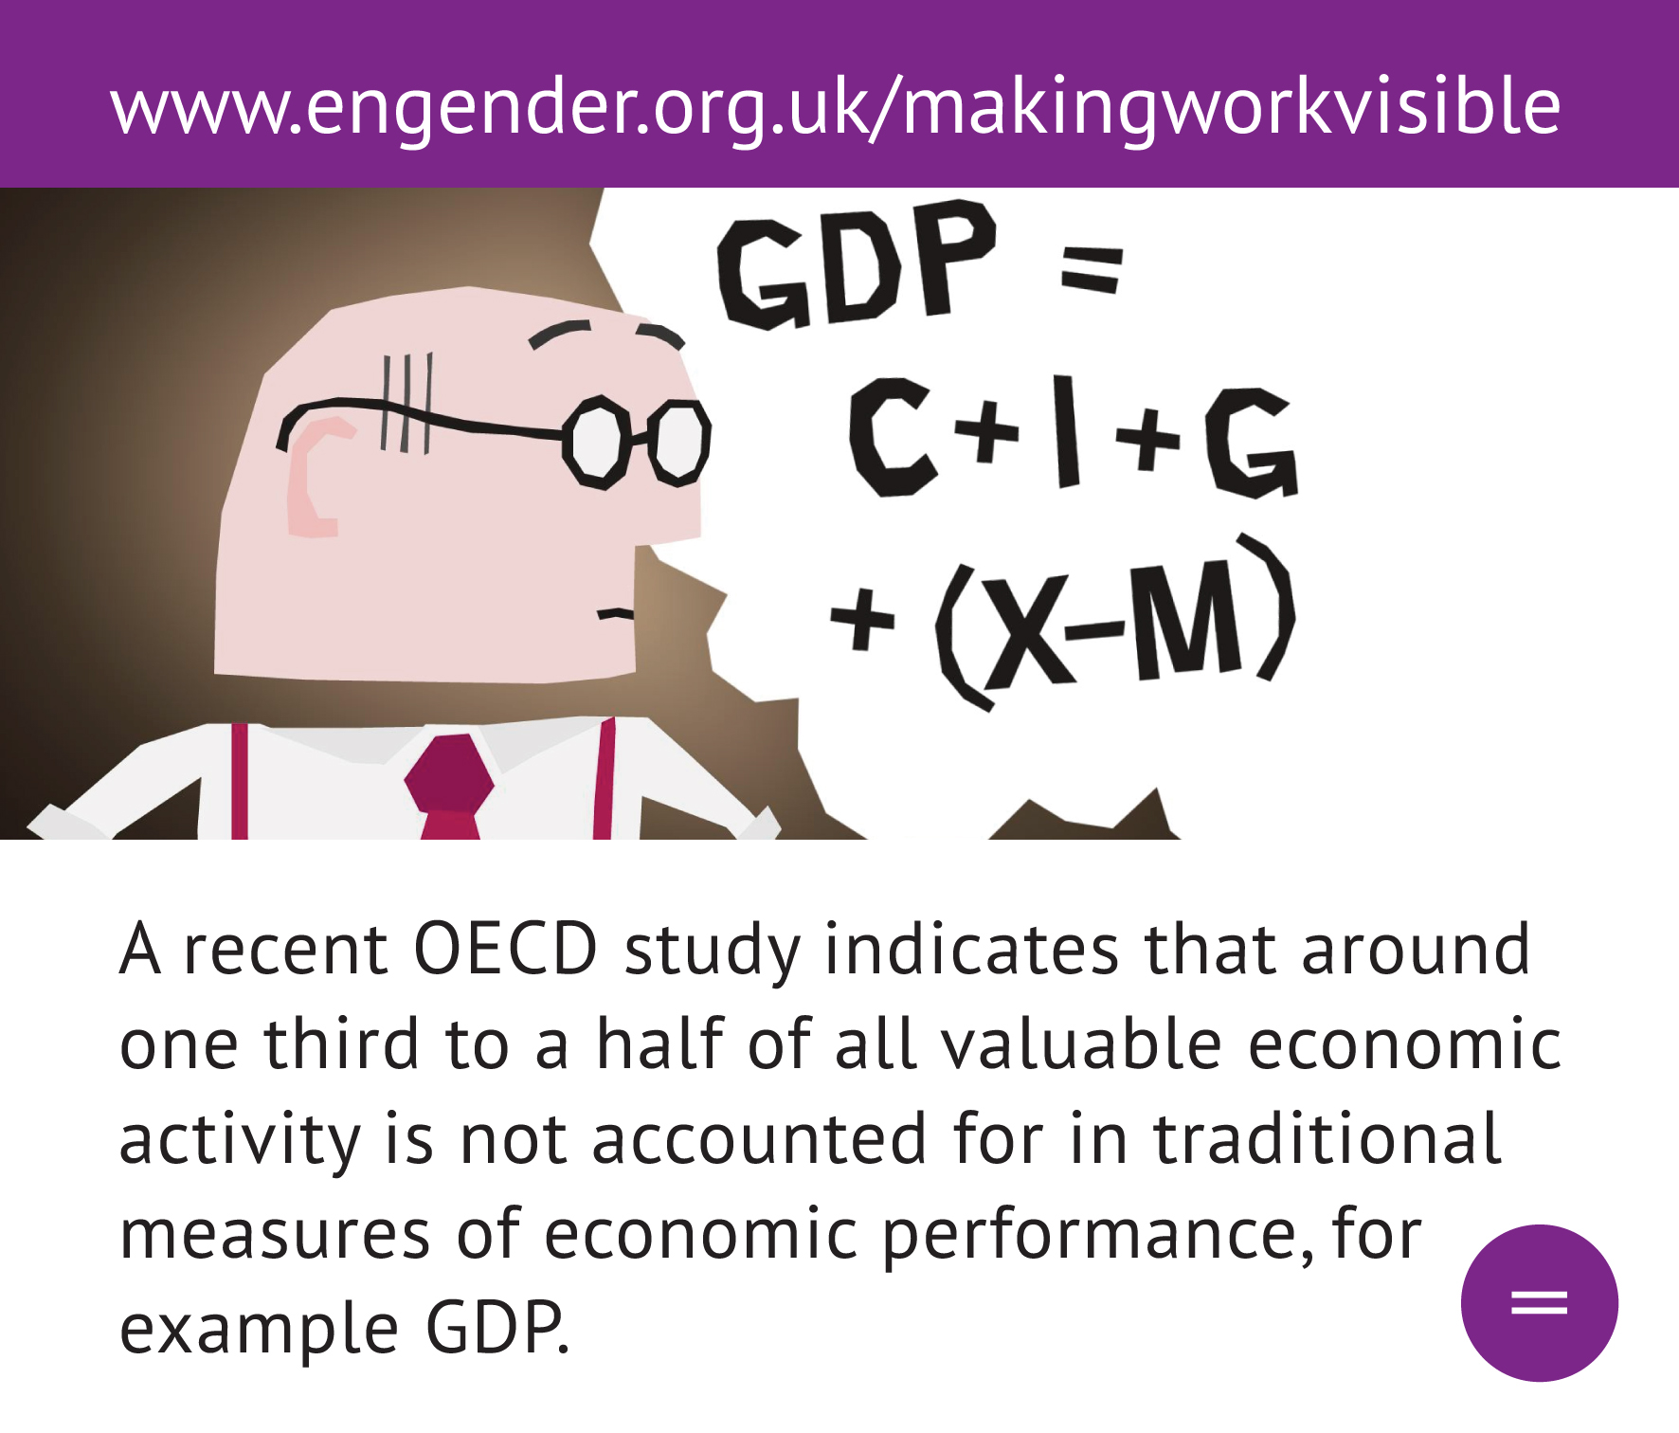
‘Marginal Eyes’
https://www.youtube.com/watch?v=W8cFfgsRtKE

Slide 12
Gender in policy making: Spotting gender at work in policy
Common patterns evidenced in policy analysis:
Gender blindness – treating male as norm e.g. no/inappropriate pensions provision for women taking care breaks
Gender bias – (usually) prioritising/rewarding men’s behaviour or status and ignoring or penalising women’s status, e.g. tax rate changes
Instrumentalising existing gender inequalities e.g. women’s lower pay or disproportionate unpaid care
Outcome: the state perpetuates gender inequalities, even unintentionally.

Slide 13
Gender and Policy Making : AndroCentric Assumptions in Policy - Examples
The equalities impact assessment for the reduction in fuel duty ( costing £1,900 m in 2011/12) says:
“Motorists who drive the same car and drive the same number of miles should broadly be affected by the same amount.”
Does not take into account differences in the car use by women and men or of different social groups.

Slide 14
Women and economics
Women are 27% of all academic staff in economics departments in the UK (compared to 17% in 2996)
Women are under-represented among professors – one in three men are professors compared to one in six women
The proportion of women is higher in research jobs than in standard academic jobs
27% female full time undergraduates
PhD students 30% female
(Royal Economic Society Survey on the Gender Balance of Academic Economics 2014)

Slide 15
Women and decision making
49,900 women corporate managers and directors = 33% of the total (Annual Population Survey Workplace 2017)
Female representation in management occupations has hovered around 33% (+/- 2%) for the last ten years (APS 2018).
women make up only 25% of Company Directors in the FTSE100 and there were no female CEOs (Engender 2017)
28% of Public Body Chief Executives (Ibid).
Political decision-making
208 MPs = 32% (2017)
206 peers = 26%
45 MSPs = 35% (2016)
AMs = 30%
MEPs = 41%
Local Councillors Scotland = 24%
2004/05
2014/15
2015/
2016/17
% women
board members
35
38
42
45

Slide 16

Next presentation: Gender Mainstreaming
In the next session
How to ensure public policy isn’t creating gender inequalities
Introducing Gender Mainstreaming

Slide 17

In This Session …
What is gender mainstreaming?
Where does it come from?
What are the policies and structures underpinning it in Scotland?
How to do Gender Impact Assessment
Example case study of implementation

Slide 18
Gender Mainstreaming – definitions
Developed in NGOs in 1970s and 1980s
Internationally agreed best practice gender equality policy since the ’90’s
Adopted by over 140 states world wide, and the EU (including Directives).
Gender Mainstreaming is:
“The (re)organization, improvement, development and evaluation of policy processes, so that a gender equality perspective is incorporated in all policies, at all levels and at all stages by the actors normally involved in policy making” Council of Europe (1998) 'Gender Mainstreaming: Conceptual Framework, Methodology and Presentation of Good Practices:

Slide 19
Gender Mainstreaming – definitions (cont)
“[Gender mainstreaming is] the systematic integration of the respective situations, priorities and needs of women and men, in all policies and with a view to promoting equality between women and men, and mobilizing all general policies and measures, specifically for the purpose of achieving equality by actively and openly taking into account, at the planning stage, their effects on the respective situation of women and men in implementation, monitoring and evaluation” – EU Commission Communication 1996 Incorporating Equal Opportunities for Women and Men Into All Community Policies and Activities
United Nations Beijing Platform for Action in 1996 obliged all signatories to implement

Slide 20
Gender Mainstreaming – definitions (cont)
“[Gender mainstreaming is] the systematic integration of the respective situations, priorities and needs of women and men, in all policies and with a view to promoting equality between women and men, and mobilizing all general policies and measures, specifically for the purpose of achieving equality by actively and openly taking into account, at the planning stage, their effects on the respective situation of women and men in implementation, monitoring and evaluation” – EU Commission Communication 1996 Incorporating Equal Opportunities for Women and Men Into All Community Policies and Activities
United Nations Beijing Platform for Action in 1996 obliged all signatories to implement

Slide 21
Whats special about gender mainstreaming?
The target groups of Gender mainstreaming are policy makers and the state!
Differs from other gender equality policy approaches e.g. anti-discrimination or positive action/equal opportunities
Tinkering (anti-discrimination); tailoring (equal opportunities), transforming (gender mainstreaming) (Rees 1998, 2005)
Gender Mainstreaming is different because its based on a structural understanding of gender
Recognition of the state’s power to maintain inequalities or promote equality

Slide 22
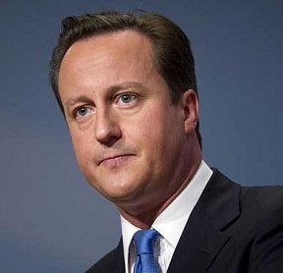
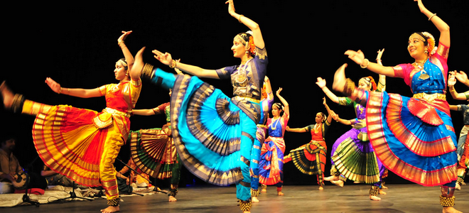
Gender Bias is Not always Explicit or conscious!
“a lot of schools were … doing things like Indian dance or whatever, that you and I probably wouldn't think of as sport” – Aug 2012

Slide 23
Gender Mainstreaming - Methods and tools For implementaTion
Gender Mainstreaming encompasses all levels of the policy process - horizontal & vertical
Tools:
Formal and political commitments: Government programmes; legal obligations; administrative requirements; and funding requirements at national, regional and local levels of governance.
Institutional structures: contact persons or focal points in Ministries; inter-ministerial coordination structures; regional and local institutional structures; consultation processes with the governmental equality body and the independent equality body; and participation processes for civil society organisations.
Dedicated tools e.g. gender impact assessment; gender budgeting; gender training; gender equality plans; and gender sensitive monitoring and evaluation.

Slide 24

Formal Commitments to Gender Equality and Mainstreaming
Equalities Act 2010 (Public sector equality duty)
Scottish Minister’s proposals to enhance performance of the Public Sector Equality Duty 2013-2017
The Equality Act 2010 (Specific Duties) (Scotland) 2012 – EIAs
Equalities Budgets Statements
Equalities commitments in Fair Work; Child Poverty Development Plan
(EU Directives mandating creation of anti-discrimination bodies and collection of gender disaggregated statistic)

Slide 25
Institutional Structures
Parliamentary Committee for Equalities and Human Rights
First Minister’s National Advisory Council on Women and Girls
‘The Circle’ (see https://tinyurl.com/yawuyx5d for both)
Scottish Human Right’s Commission
Scottish Government Equality Unit (& mainstreaming team)
Equality Budget Advisory Group (https://tinyurl.com/y7pu2gml)
Ministerial Working Group on Gender Pay Gap
Gender Data Working Group
Equalities Evidence Finder

Slide 26
Civil Society - Examples
Scottish Equality and Human Rights Commission
Engender
Scottish Trades Unions Congress
Scottish Women’s Convention – promoting women’s voice in decision making
Close the Gap – addressing gender inequalities in work
Scottish Women’s Budget Group
Women’s Enterprise Scotland
Amina – Muslim Women’s Resource Centre;
Sahelia BME women’s organisation
EQUATE Scotland – Women in Science and Engineering

Slide 27
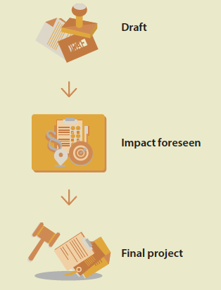
Gender Impact Assessment – 4 Steps
Step 1 - Identify the policy’s purpose and target groups
Step 2 – Identify existing inequalities relevant to the planned proposal
Step 3 – Analysis of the planned policy’s gender impacts
Step 4 - Findings and Recommendations

Slide 28
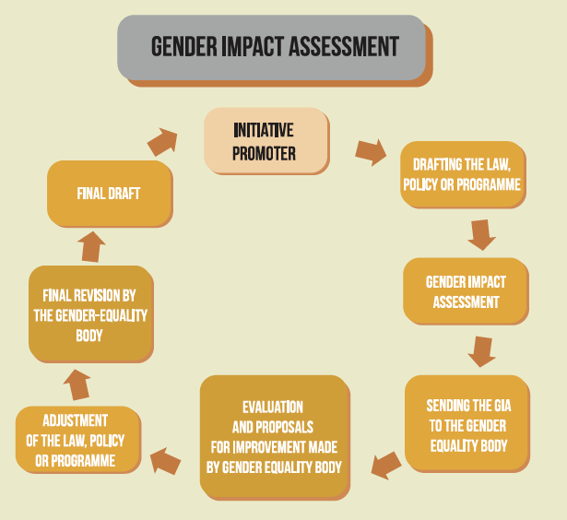
Gender Impact Assessment

Slide 29
Resources and toolkits - Examples
European Institute for Gender Equality Toolkit: https://tinyurl.com/y96x7btt
Close the Gap Equality Impact Assessment (employment/labour market) https://tinyurl.com/ycrpmw5w
Equality and Human Rights Commission – Mainstreaming the Equality Duty: A Guide for Public Authorities in Scotland https://tinyurl.com/yalo3slg
Women’s Budgets Group - Gender Responsive Budgeting Toolkit https://tinyurl.com/y9j2cc4y

Slide 30
Step 1: analyse the Planned Policy’s aims and their relation to gender equality
What problem or issue is being addressed by this policy/legislative intervention?
Why is this intervention being considered?
Is the intervention (already) intended to contribute to gender equality? If yes, how?
What are the existing gender equality objectives in this field?
Who is/are the policy’s primary target group(s)? This can include people and legal entities.
What will the direct and indirect impacts of the planned policy be, on these target groups?

Slide 31
EU Commission – Research and Innovation Policy
Develop the EU’s international competitiveness in science
Co-ordinate research activities within the EU across Member States
Build research capacity across the EU
Support other policy fields such as environment, health and socio-economic problems
Promote understanding of the role of science in a modern society

Slide 32
Step 1: analyse the Planned Policy’s aims and their relation to gender equality
What problem or issue is being addressed by this policy/legislative intervention?
The need for scientific competitiveness
Why is this intervention being considered?
Well documented skills shortages and lack of competitiveness
Is the intervention (already) intended to contribute to gender equality? If yes, how?
No
“DG Research should encourage the participation of women” + GM commitments
What are the existing gender equality objectives in this field?
Who is/are the policy’s primary target group(s)? This can include people and legal entities.
Research projects receiving research funds;
What will the direct and indirect impacts of the planned policy be, on these target groups?
Researchers will work on specified topics and mobility will be encouraged

Slide 33
Step 2 : identify existing inequalities
Broadly equal numbers of women entering scientific careers but stark vertical segregation and patterns of horizontal segregation
Evidence of widespread discrimination – stereotypes that women aren’t scientific or dedicated
Mobility policies penalising women with families
Lack of policies to enable return to work after maternity
Inequalities into research on women’s needs/interests (e.g in health, product design)
Conduct research to find out what these are – searched for statistics, papers and comparable GM policies in science
Consult with civil society/relevant user groups – contacted existing experts/practitioners in gender and science and local gender equality unit
Consider 3 domains of inequality between women and men:
Division of labour by gender – paid/unpaid labour; occupational segregation
Organisation of private life – violence, reproduction, caring responsibilities
Organisation of citizenship – access to and control over resources; decision making

Slide 34
Step 3 Analysis of Gender Equality Impacts
None of the measures in draft policy will help to remedy existing inequalities
Project assessment criteria likely to entrench/reproduce patterns of vertical and horizontal segregation by using the same assessment criteria
Mobility policies likely to entrench penalties in women’s careers
Commissions (draft) research priorities entrench lack of focus on women’s interests/needs
Data to monitor equality impacts is not collected

Slide 35
Conclusions and recommendations
Recommended changes to the policy in order to tackle existing inequalities and actively promote gender equality
Science ‘by, for and on’ women. GE inserted into strategic objectives
Gender sensitive topics identified – identified annually by panel of gender experts
Gender sensitive research rewarded in assessment criteria (Gender Action Plans)
40% target set for female participation on all assessment panels and decision making
Intra departmental gender working group established
Monitoring indicators required to track gender equality impacts
EU wide sex-disaggregated data collection on scientific participation launched (5 indicators)
Prevalence of gender sensitive research monitored
Gender disaggregated data on project success rates and decision making monitored

Slide 36
Gender impact assessment is a learning process
“I wasn’t knowledgeable at all … I [had to] take knowledge from colleagues knowing women’s issues and analyse them with our policy to see how we could mainstream gender. You need these two knowledges”
We had to understand and translate … recognise .. It is not only counting women in labs. Its [science] by for and about women. Putting together all the different dimensions … making sure research serves women’s needs”

Slide 37


Slide 38
Group exercise: 4-step Gender Sensitive Impact Analysis
Transport Bill 2018
The Transport (Scotland) Bill is designed to help make Scotland’s transport network cleaner, smarter and more accessible than ever before. It aims to empower local authorities and establish consistent standards in order to tackle current and future challenges, while delivering a more responsive and sustainable transport system for everyone in Scotland.
The Bill takes forward a number of Scottish Government commitments from its 2017-18 Programme for Government.
Step 1- Definition of policy purpose
Step 2 – Identify existing inequalities
Thinking about women and men’s lives in terms of
Division of labour
Organisation of private life
Organisation of citizenship
Step 3 – Analysis of policy’s gender impacts
Step 4 – Findings and recommendations

Slide 39
Resources
Public Transport and Gender: https://wbg.org.uk/analysis/2018-wbg-briefing-transport-and-gender/
Gender Impact Assessment Guide: https://eige.europa.eu/gender-mainstreaming/toolkits/gender-impact-assessment
Women’s Economic Empowerment and Inclusive Growth: https://nailakabeer.net/2012/12/08/womens-economic-empowerment-and-inclusive-growth-labour-markets-and-enterprise-development/
Sustainable Gender Equality: https://vimeo.com/77692813

